Slide 1
Bash Commands Cheat Sheet

Slide 2
Command | Meaning | Usage
ls | lists everything in a directory ls | [options] [folder]
echo | prints text to a location | echo [phrase]
mkdir | create new directory | mkdir [folder name]
cd | change directory | cd [directory]
touch | make new file without any content | touch [file name]
more | view file one screen at a time | more [file]
cat | print full contents of file | cat [file]
mv | move file to a different location, rename file/folder | mv [file] [new location] mv [old name] [new name]
pwd | move file to a different location, rename file/folder | mv [file] [new location] mv [old name] [new name]
wc | count the number of lines/words/bytes in a file | wc [options] [file]

Slide 3
ls: lists everything in a directory
○ Useful options:
■ -a show all files (including ones that start with .)
■ -l use long listing format (file sizes, dates, permissions, etc)
■ -h use human readable format (1G, 27K, 736M)
■ -t sort by time with newest first
■ -o similar to -l, but without group permissions
■ -r reverse the order while sorting
○ Usage: ■ ls -thor ■ ls -alh Desktop/

Slide 4
wc: count the number of lines/words/bytes/characters in a file
○ Default (no options) prints out: line count word count byte count
○ Useful options:
■ -c print the byte count
■ -l print the line count
■ -m print the character count
■ -w print the word count
○ Usage:
■ wc file.txt
■ wc -l file.txt

Slide 5
echo: prints text to a location
○ Important notes:
■ Using > file after the command will put the text in the file
■ Using >> file after the command will append the text to the end of the file.
○ Usage:
■ echo “hello”
■ echo “hello world” > file.txt
■ echo “hello student” >> file.txt

Slide 6
Operator | Meaning | Usage
| | Pipe, used as “and” or used to use the output of the first command as the input of the second command. | echo “hello” | echo “world” ls | wc -l
> | Output, put the output of the command into a file | echo “hello” > file.txt
>> | Append, add the output of a command to the end of a file | echo “hello” >> file.txt
* | Wildcard, used as a placeholder for any character for zero or more times | cat file*

Slide 7
Terminology
String
Sequence of characters and can contain letters, numbers, symbols and even spaces.
RegEx
Regular Expression, a pattern (or filter) that describes a set of strings that matches the pattern.
grep
A command-line utility for searching plain-text data sets for lines that match a regular expression.
FASTA
A text-based file format for representing either nucleotide sequences or amino acid sequences.
sed
A stream editor that can perform lots of functions on file like searching, find and replace, insertion, or deletion.

Slide 8
Command | Meaning | Usage
rm | Remove, delete a file. Use -r to delete a directory and all of its contents. | rm [file] rm -r [directory]
clear | Clears all the text on the screen. | clear
grep | Finds text that matches a pattern and returns the lines containing that text. | grep [options] "[regex]" [file]
sed | Stream editor. Diverse command that can manipulate text/files. | sed [options] '[regex]' [file]
tr | Translate, change or delete characters in a file. | file. tr [options] [old format] [new format]

Slide 9
Operators To Know
Operator | Meaning | Usage
&& | And. Use between two commands to do both commands | echo "hi" && echo "bye"
^ | Find matches that are at the beginning of a line. | grep "^ATG" example.fasta
$ | Find matches that are at the end of a line. | grep "TAG$" example.fasta
| | Pipe, or. Use between two regex matches to match both. | grep "hi|bye" file.txt
. | Match any single character | grep "wh." file.txt

Slide 10
grep: finds text that matches a pattern and returns the lines containing that text
○ Useful Options
■ -c This prints only a count of the lines that match a pattern
■ -n Display the matched lines and their line numbers.
■ -v This prints out all the lines that do not matches the pattern
■ -E Treats pattern as an extended regular expression (ERE)
■ -o Print only the matched parts of a matching line, with each such part on a separate output line.
-A [number_of_lines] ets the specified number of lines after a match
-c returns the number of times the pattern is found
○ Usage
■ grep -cv "hello" file.txt file1.txt file2.txt
■ egrep -o "hi|bye" file.txt OR grep -Eo "hi|bye" file.txt
■ grep -n "hello" file.txt

Slide 11
Full List of grep Options
● -c This prints only a count of the lines that match a pattern
● -h Display the matched lines, but do not display the filenames.
● -i Ignores, case for matching
● -l Displays list of a filenames only.
● -n Display the matched lines and their line numbers.
● -v This prints out all the lines that do not matches the pattern
● -e Specifies expression with this option. Can use multiple times.
● -f Takes patterns from file, one per line.
● -E Treats pattern as an extended regular expression (ERE)
● -w Match whole word
● -o Print only the matched parts of a matching line, with each such part on a separate output line.
● -A n Prints searched line and n lines after the result.
● -B n Prints searched line and n line before the result.
● -C n Prints searched line and n lines after before the result.

Slide 12
Command Breakdown - sed
Command Breakdown:
sed -i 's/hello/world/g' file.txt
substitute / regex match/ replacement/flags
sed '/[a-z]/d' file.txt
regex match/ delete

Slide 13
sed's Useful Options, Commands, & Flags
● Options
○ -i In-place, files are edited rather than printing output to the terminal
○ -E or -r Use extended regular expressions rather than basic regular expressions (similar to using egrep)
● Commands
○ s/[m]/[r]/[flags] Substitute, match the regex ([m]) in a file and replace matched string with [r]
○ /[m]/d Delete, delete the line containing the regex match [m]
○ [#]a [text] Append, appending text after line [#] (use i for before)
● Flags
○ /g Global, apply the replacement to all matches, not just the first
○ /I Case Insensitive, match the regex case insensitively
○ /[#] Nth, only replace the Nth match of the regex

Slide 14
Command Breakdown - tr
● tr: translate, change or delete characters in a file
○ Options
■ -c Complement, apply other option to characters not in the given string
■ -d Delete character(s)
■ -s Squeeze, replace repeated characters with a single occurrence
■ -t Truncate, if set 1 is larger than set 2, the size of set 1 will be matched to the size of set 2 (unavailable on Mac)
○ Usage ■ tr [options] [set 1] [set 2]

Slide 15
tr Examples
● cat file.txt | tr "[a-z]" "[A-Z]"
○ Turns all lowercase letters in file.txt into uppercase letters
● tr "[:lower:]" "[:upper:]" < file.txt
○ Turns all lowercase characters in file.txt into uppercase characters
● echo "This Is Lab2" | tr -s " "
○ Removes repeated spaces, output: This Is Lab2
● tr -d T <<< "This Is Lab2"
○ Deletes T, output: his Is Lab2
● echo "this is course number 199384" | tr -cd "[:digit:]"
○ Removes everything except digits, output: 199384
● tr -t 'isef' '12' <<< "This is Lab2"
○ Replace is with 12, ignore replacing ef, output: Th12 12 Lab2

Slide 16
tr (translate - syntax anatomy unix tool)
tr [option] set 1 [set2]
-c complement
-d delete
-s
-t truncate
tr(no options = substitute[ original][new]

Slide 17
RegEx Breakdown
● RegEx: regular expression, a pattern (or filter) that describes a set of strings that matches the pattern
○ Commonly Used Patterns:
■ \d or [[:digit:]] or [0-9] Any number from 0 to 9
■ \w or [[:alpha:]] or [A-Za-z] Any letter, regardless of capitalization. \w includes numbers
■ \s or [[:space:]] Any whitespace character (space, tab, newline, carriage return, form feed, and vertical tab)
■ [A-Z] or [[:upper:]] Any uppercase character
■ [a-z] or [[:lower:]] Any lowercase character
■ \n New line
■ \t Tab
■ [^match] Anything but match, [^a-z] any non-lowercase character

Slide 18
Commands
Login to Cluster | ssh -l [username] hpc-student.uncc.edu ssh [username] @hpc-student.uncc.edu
Upload a file on MAC | scp [local_file_name] [user]@ hpc-student.uncc.edu:[directory/in/cluster]
Extracting a tar.gz file | tar -xvf [file.tar.gz]
Interactive view of the file | less [file_name]
Search for a module in the cluster | module search [search_term]
Load a module to use on the cluster | module load [module_name] ml [module name]
Cp copy a file | cp [source_file] [destination_file]
Launch nano to edit a file in command line | nano [file_name]

Slide 19
Commands
Submit a slurm script to the scheduler | sbatch [instructions].slurm
See your currently running jobs | squeue -u [username]
Convert multi-line fasta file into one line file | awk '/^>/ {printf("\n%s\n",$0);next; } { printf("%s",$0);} END {printf("\n");}' < [INPUT_FILE].fasta > [OUTPUT_FILE].fasta
Redirect output to save to a new file | [commands] > [output_file]
Delete all empty lines file | grep -v -e ‘^$’ file awk ‘!/^$/’ file
Delete all the white space (tabs or spaces within the empty line) | grep -v -e ‘^[[:space:]*$’ file awk ‘NF > 0’ file Sed ‘/^[[:space:]]*$/d’

Slide 20
Commands and Software
SRA Tools | Command for downloading SRA Data Command for splitting pair sequencing reads | prefetch [SRA_ID] fastq-dump --split-e [SRA_ID}.sra
Trimmomatic | Run using java | java -jar /apps/pkg/trimmomatic/0.39/trimmomatic-0.39.jar [PE/SE] [options]
Fast QC | Assess the quality of the reads | fastqc [reads_to_be_analyzed]

Slide 21
General comments
TSV | Tab separated
CSV | Column separated
Column oriented Data | spreadsheets , CSV, Tabular, Delimited Fixed
XML | Machine readable Compled, nested structures, multiple values,
Key Value format | Easy to read Straight forward to parse

Slide 22
CSV
david,abdul,xi,bill
mary,david,bill,abdul
wang,abdul,xi,david
TSV
David
abdul
xi
bill
Mary
david
bill
abdul
Wang
abdul
xi
david

Slide 23
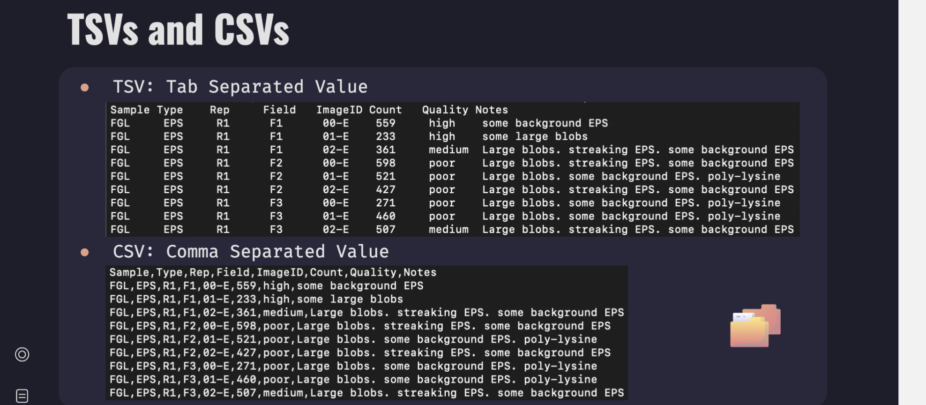

Slide 24
Commands
sort [options] file.txt
-t “t” set the delimiter when using -k
default is non-blank to blank transition
-k 3
sort column #3 (left is 1)
-k 2,3 sort multiple columns
-n sort numerically
-r reverse sort order
-u drop duplicates from the result
-b, --ignore-leading-blanks, ignore leading blanks
-d, --dictionary-order consider only blanks and alphanumeric characters
-f, --ignore-case fold lower case to upper case characters
No options: sort alphabetically from leftmost character.
sort [options] file.txt

Slide 25
Commands
cut [options] file.txt
gcut [options] file.txt
-d (--delimiter) “,” set field delimiter (default tab)
-f (--fields=LIST) Select by specifying a field
-f 2 select a field to cut (left is 1)
-f 2-8,12 select multiple fields to cut
-b (--bytes=LIST) Select by specifying a byte
-c (--characters=LIST) Select by specifying a character
--complement - Complement the selection.
-s (--only-delimited) suppress non-matches

Slide 26
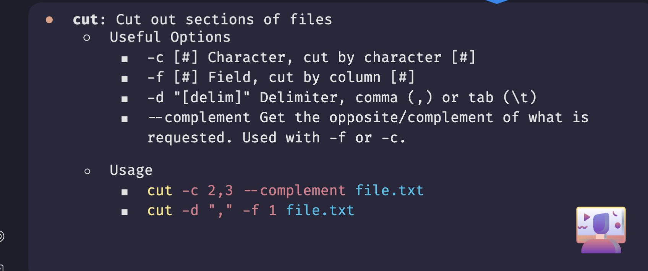
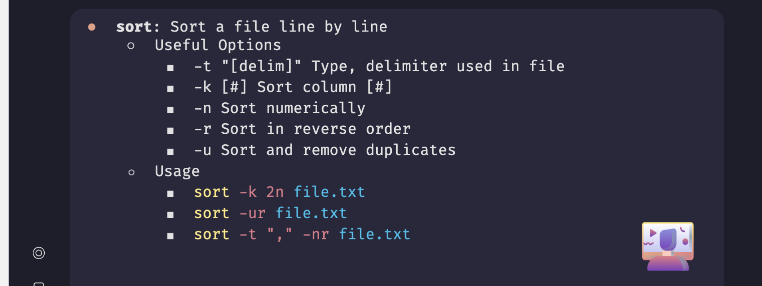

Slide 27
Commands
uniq [options] file.txt
Only works on sorted files and adjacent lines!
-c count lines for each unique value
-d only report duplicated lines
-u only report non-duplicated lines
No options: drop all duplicated lines (keeps 1 copy)

Slide 28
Whats does echo$PATH mean??
Your open path that tells you what is executable
Writes your path list of executable files
How would you put something in your path??
Export
Or manually edit

Slide 29
What do these commands do??
gcut -f1,4 -d“,”file.csv --complement
prints all but columns 1 and 4

Slide 30
What does this command do?
egrep -v ‘^$’ file.tsv
Delete all empty lines
If i had a file with lots of repeated lined who would i count the unique lines ??
sort -k1 file.txt | uniq - c
Sorting from first column | piping to uniq.. Is there anything unique within column 1 ?? - c is counting
-c counts -u only prints unique lines

Slide 31
What does this command mean??
How to remove empty lines/white space ??
grep -v-e ‘^[[:space:]]*$’file
awk ‘NF >0’ file
sed '/^[[:space:]]*$/d' file

Slide 32
Explanation
In doppelganger_name.txt count how many time the name ‘chi’ is left to the name ‘bill’
Using grep only command:
grep -oE ‘chi’$’\t”bill’ doppelganger_names.txt|wc-l
Using grep with printf command:
Gep -oE “chi$(prinf\t’)bill” doppelganger_names.txt|wc-l
awk
Awk ‘/chi\tbill/’ doppelganger_names.txt|wc-l

Slide 33
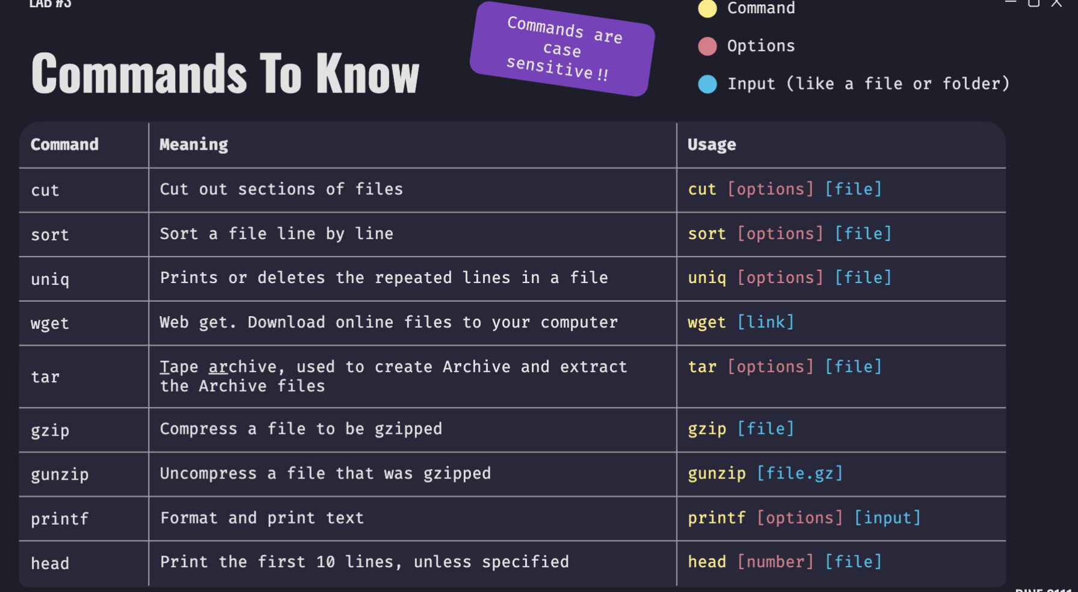
Commands

Slide 34
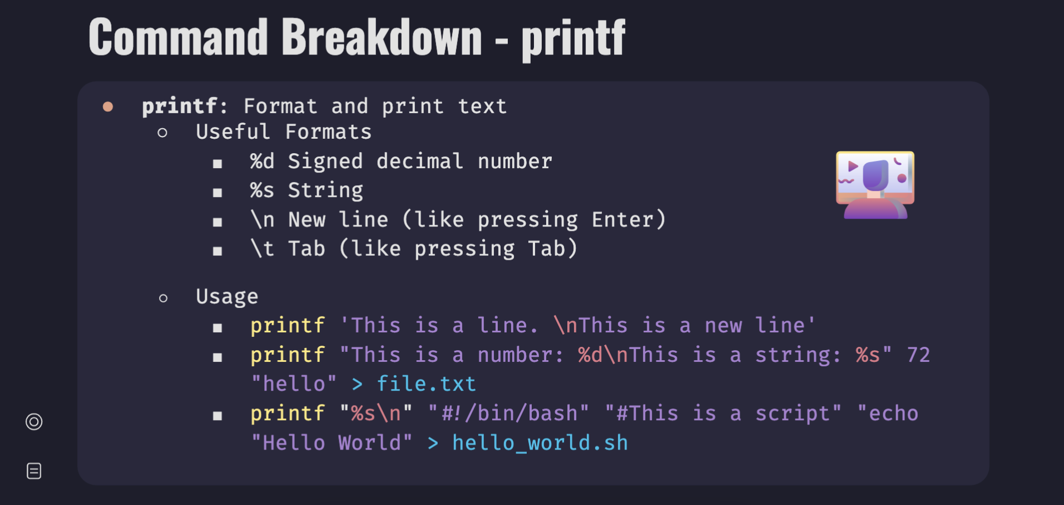

Slide 35
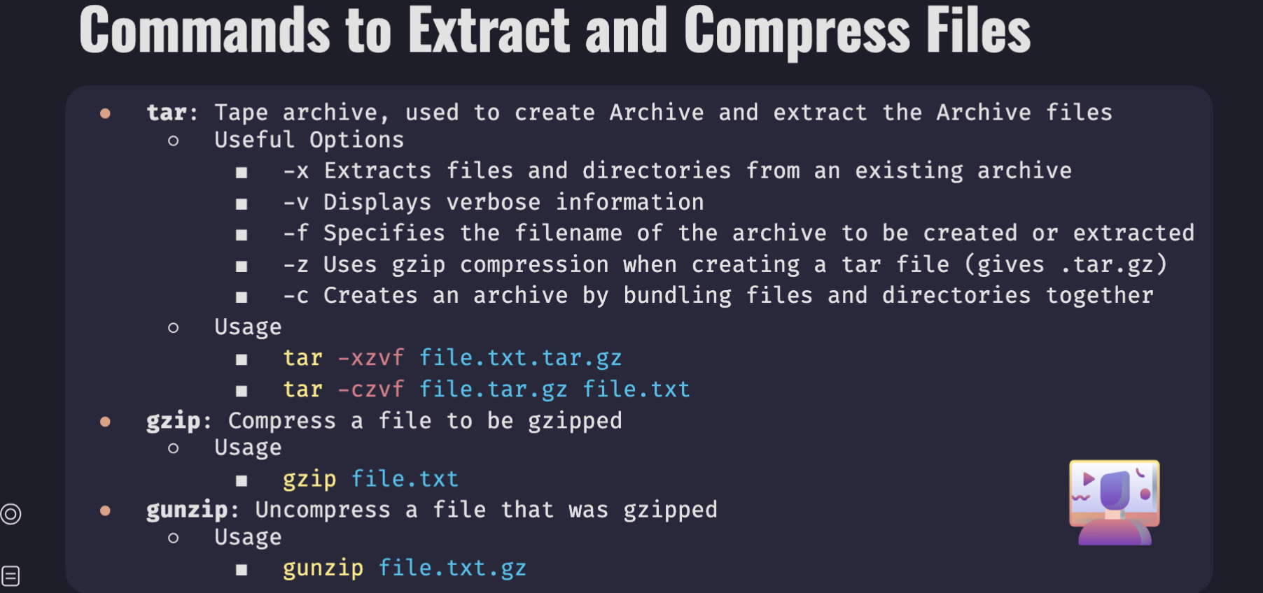

Slide 36
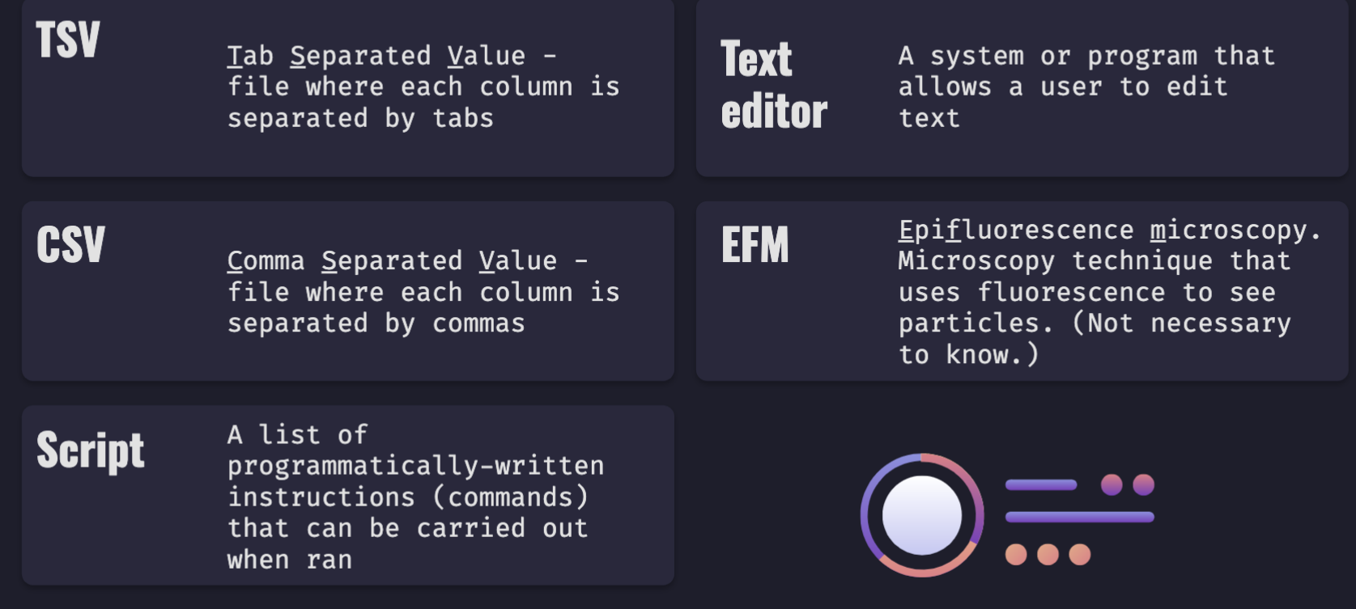

Slide 37
Bash Reserved words

Slide 38
TSV to CSV
Convert tsv to csv :
sed -s ‘/\t/,/g’ tsv<csv
cat file.tsv | tr -s ‘\t’,’ >file.csv

Slide 39
Explanation
Extract sequence in example2.fasta that has one or more atg
grep "ATG” example2.fasta --color
grep ‘ATG.*ATG’ example2.fasta >extracted.fasta

